Slide 1
Nepali Digits Classification
Final Year Project Title Defence
On
Presented By:
Aashish Pokharel (20786/075)
Milan Chaudhary (20811/075)
Shreedhar Ghimire (20827/075)
January, 2023

Slide 2
Overview
Problem Statement
Objectives
Scope & Limitation
Literature Review
Why “Nepali Digit Classification”?
System/Algorithm Overview

Slide 3
Problem Statement
Handwritten Nepali Digit Classification has been a topic of research for the recognition of the Nepali digits. This has been a difficult task because of the complexity and variations in the handwritten Nepali Devanagari digits,
This has led to inconsistent result in a Nepali digit and character as a whole,

Slide 4
Objectives
Following are the objectives of the system:
To identify Nepali digits using Deep Learning Approaches,
To perform hyperparameter tuning to create a more efficient model,

Slide 5
Scope and Limitations
The project tries to implement a system that will be able to take inputs from user and recognize which nepali digit is given as input.
The System has following limitations:
The system will not be able to recognize Nepali characters other than the digits,
The system will not be able to perform online prediction,

Slide 6
Literature Review: Neural Networks
Handwritten digit classification using Neural Networks has been a topic of research for a long time. It has seen a lot of progress in the recent years due to availability of resources for the computation.
In [1], author discusses the various algorithms that could be used for Character Recognition such as logistic regression, Support Vector Machines, etc although these may provide analytical and computational properties but that their practical applicability is limited by the curse of dimensionality. In order to apply such models to large scale problems, it is necessary to adapt the basis functions to the data…..

Slide 7
Literature Review: Neural Networks
The approach is to fix the number of basis functions in advance but allow them to be adaptive, in other words to use parametric forms for the basis functions in which the parameter values are adapted during training. The most successful model of this type in the context of pattern recognition is the feed-forward neural network, also known as the multilayer perceptron. [1]
The implementation of Neural Networks in Character Recognition can be found as early as 1998 by LeCun et al. [3] with an error rate as low as 12% using a single perceptron model. Further use of deeper Neural Networks have been done and results with error less than 1%.

Slide 8
Literature Review: Nepali Character Recognition
In [4] published by Yadav, Cuadrado and Morato, in 2013 used ANN’s for Devanagari OCR and achieved an accuracy of 90% in character recognition. However, the given accuracy is for only 5 fonts. In this paper, they propose an OCR for printed Hindi text in Devanagari script, using Artificial Neural Network (ANN), which improves its efficiency. One of the major reasons for the poor recognition rate is error in character segmentation.

Slide 9
Literature Review: Nepali Character Recognition
In this work, three feature extraction techniques-:
1. Histogram of projection based on mean distance,
2. Histogram of projection based on pixel value, and
3. Vertical zero crossing, have been used to improve the rate of recognition.
These feature extraction techniques are powerful enough to extract features of even distorted characters/symbols. For development of the neural classifier, a back-propagation neural network with two hidden layers is used. The classifier is trained and tested for printed Hindi texts. A performance of approximately 90% correct recognition rate is achieved.[4]

Slide 10
Literature Review: Nepali Character Recognition
In another study by Nirajan Pant and Balkrishna Bal, [5] proposes a hybrid OCR system for printed Nepali text using the Random Forest (RF) Machine Learning technique.
It incorporates two different approaches of OCR –
The Holistic level and,
The Character level recognition.

Slide 11
Literature Review: Nepali Character Recognition
The system first tries to recognize word as a whole; if it is not confident about the word being recognized, then the character level recognition is performed. The recognition rates of approximately 78.87% in test set and 94.80% for training set were achieved for character level recognition method and the Hybrid method respectively. They attempted to minimize the segmentation errors by reducing the segmentation tasks.[5]

Slide 12
Literature Review: Nepali Character Recognition
Similarly in [7], Sharma and Bhattarai in 2017 have shown a high character recognition accuracy using Convolutional Neural Networks. However, upon analysis of their confusion matrix, we found that they represented the character ‘ङ’ (nga) as ‘ड’ (Da) (a combination of two characters ‘ड’ and ‘.’), which resulted in a high rate of error for that character, especially since 70% of their dataset was generated artificially. This study uses Tesseract and ANN with some modifications, wherever necessary, for Nepali script.

Slide 13
Literature Review: Handwritten Digit Recognition
Likewise, in a study by Owais Mujtaba Khandey and Dr. Samad Dadvandipour, [6] covers the work done in handwritten digit recognition and the various classifiers that have been developed.
Methods like MLP, SVM, Bayesian networks, and Random forests were discussed with their accuracy and are empirically evaluated. Boosted LetNet 4, an ensemble of various classifiers, has shown maximum efficiency among these methods. The boosted LeNet 4 method performs the best with the accuracy of 99.3% and is the best among the methods that have been studied in this paper. The only tradeoff is the training time, which is very large and is about five weeks. The operational/actual recognition time is 0.05 ms.

Slide 14
Title Selection
As [7] shows there are a lot of conflicts in devanagari characters recognition such as ‘ङ’ (nga) as ‘ड’ (Da), so choosing a smaller label size(only devanagari digits) will make the project easy to optimize and get a good score,
Very few articles have been published that only include the devanagari digits classification using ANNs,
Rare availability of Nepali Character Dataset,
Focusing only on digits allows the model to be more specialized and accurate,

Slide 15
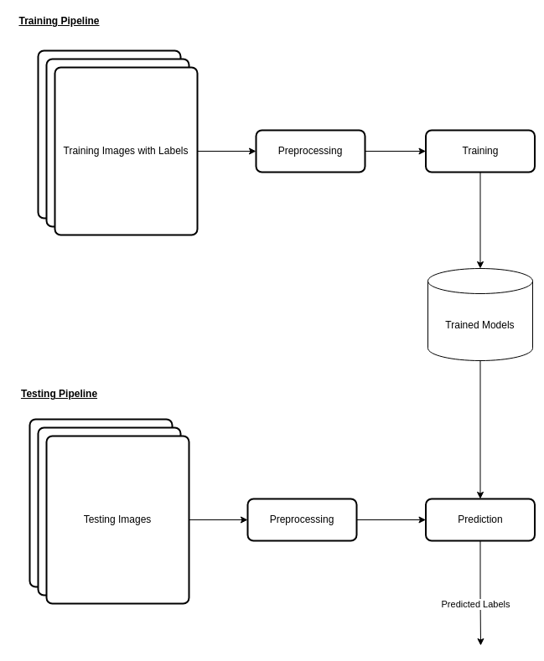
System Overview
The pipeline for training and testing of images is shown as:

Slide 16
References
[1] C. M. Bishop, “Chapter 5 - Neural Networks,” in Pattern recognition and machine learning, New York, NY: Springer New York, 2016.
[2] Y. Lecun, L. Bottou, Y. Bengio, and P. Haffner, “Gradient-based learning applied to document recognition,” Proceedings of the IEEE, vol. 86, no. 11, pp. 2278–2324, 1998.
[3] D. E. Rumelhart, G. E. Hinton, and R. J. Williams, “Learning internal representations by error propagation,” 1985.
[4] D. Yadav, S. Sanchez-Cuadrado, and J. Morato, “Optical character recognition for Hindi language using a neural-network approach,” Journal of Information Processing Systems, vol. 9, no. 1, pp. 117–140, 2013.
[5] N. Pant and B. K. Bal, “Improving nepali OCR performance by using hybrid recognition approaches,” 2016 7th International Conference on Information, Intelligence, Systems & Applications (IISA), 2016.
[6] O. Mujtaba Khandy and S. Dadvandipour, “Analysis of machine learning algorithms for character recognition: A case study on handwritten digit recognition,” Indonesian Journal of Electrical Engineering and Computer Science, vol. 21, no. 1, p. 574, 2021.
[7] M. K. Sharma and B. Bhattarai, “Optical character recognition system for Nepali language using ConvNet,” Proceedings of the 9th International Conference on Machine Learning and Computing, 2017.
[8] N. Singh, “An efficient approach for handwritten Devanagari character recognition based on Artificial Neural Network,” 2018 5th International Conference on Signal Processing and Integrated Networks (SPIN), 2018.

Slide 17
Thank You!

